Slide 1
BUILDING DIMENSIONS
REVIT University
SLAB PLANS & BUILDING PLANS
Revit UNIVERSITY – October 4th, 2023 PRESENTED BY Andres Fernandez, Christian Quintero

Slide 2
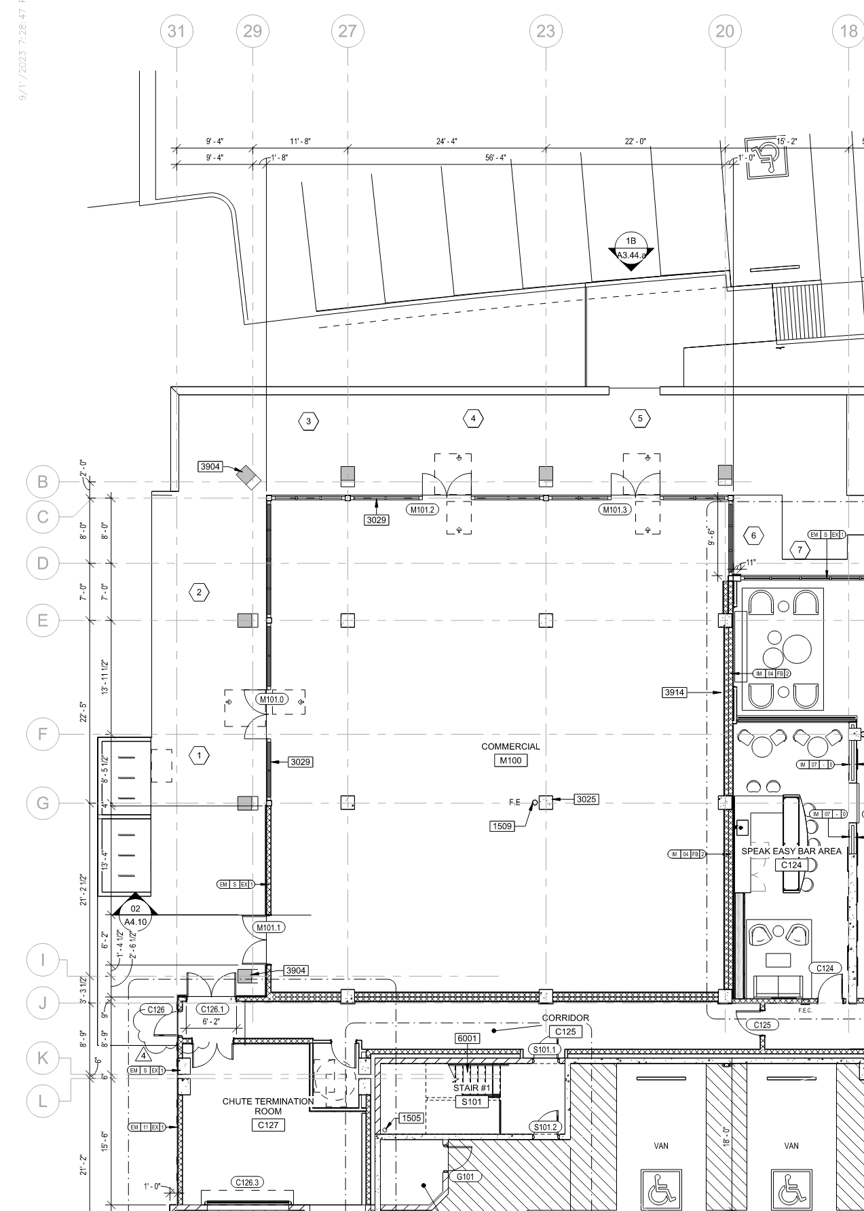
GRID LINES
GRID LINES ARE USED BY THE BUILDER TO SET ORDER TO MAIN STRUCTURAL ELEMENTS. GRID LINES ARE TYPICALLY ALIGNED TO:
EDGE OF BUILDING
STRUCTURAL COLUMNS
STRUCTURAL BEARING WALL
EDGE OF SLAB
NOT ALL PROJECTS WILL HAVE GRIDLINES
NOT ALL PROJECTS NEED TO HAVE GRIDLINES.
TYPICAL PROJECTS WITH GRID LINES:
PODIUMS
GARAGES
COMPLEX BUILDINGS
PLANS WITH GRID LINES:
SLAB PLANS
OVERALL FLOOR PLANS
ENLARGED FLOOR PLANS (SERIES 3)
REFLECTED CEILING PLANS
ROOF PLANS
ELEVATIONS
SECTIONS
PLANS WITHOUT GRID LINES:
LIFE SAFETY
UNIT PLANS
ENLARGED AREA PLANS (SERIES 5)
KEEP YOUR DRAWINGS CLEAN AND FREE OF CLUTTER

Slide 3
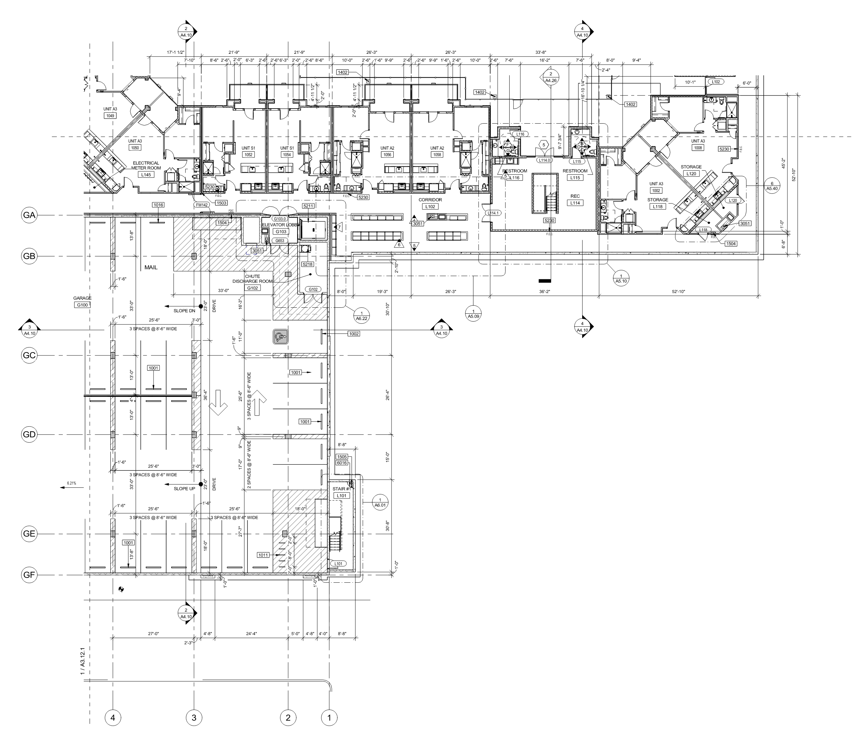
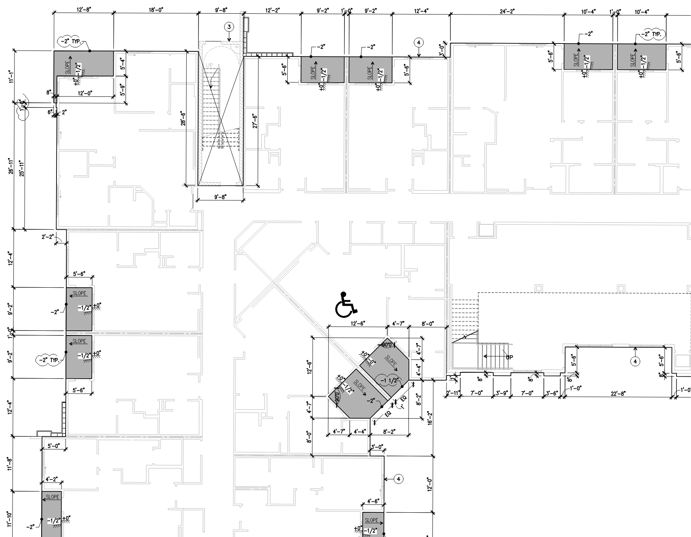
GRID LINES
NOT ALL PROJECTS NEED TO HAVE GRIDLINES.
TYPICAL PROJECTS WITH GRID LINES:
PODIUMS
GARAGES
COMPLEX BUILDINGS
IT MAY BE THAT ONLY A PORTION OF YOUR PROJECT WILL HAVE GRID LINES:
WRAP PROJECTS

Slide 4
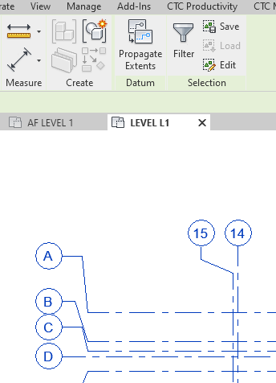
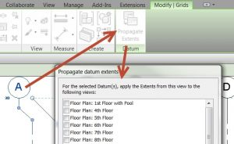
GRID LINES - REVIT
PROPAGATE EXTENTS
SET YOUR GRID OFFSETS IN ONE VIEW AND DISTRIBUTE THEM THROUGOUT SIMILAR VIEWS.
THE VIEW YOU COPY FROM, CANNOT HAVE SCOPE BOXES OR CROP REGIONS
VIEWS NEED TO HAVE THE SAME ORIENTATION
THIS CAN BE APPLIED TO ELEVATIONS AND SECTIONS AS WELL.

Slide 5
GRID LINES - REVIT
PROPAGATE EXTENTS
SET YOUR GRID OFFSETS IN ONE VIEW AND DISTRIBUT THEM THROUGOUT SIMILAR VIEWS.
THE VIEW YOU COPY FROM, CANNOT HAVE SCOPE BOXES OR CROP REGIONS
VIEWS NEED TO HAVE THE SAME ORIENTATION
THIS CAN BE APPLIED TO LEVELS IN ELEVATIONS AND SECTIONS AS WELL.

Slide 6
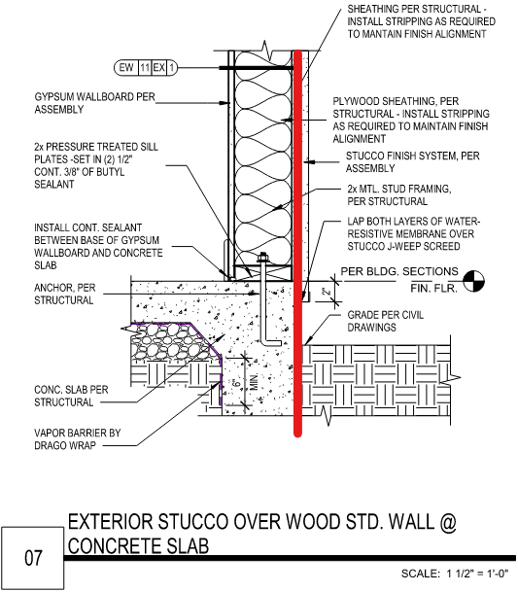
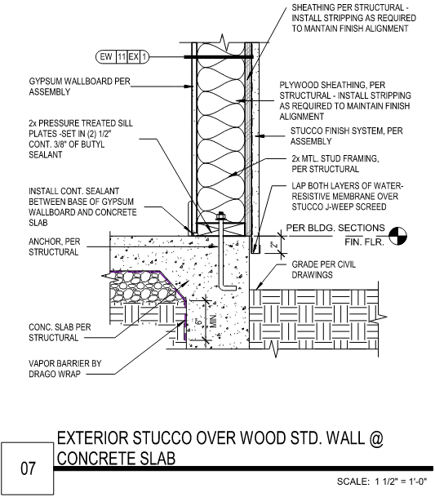
PLAN DIMENSIONS AT ORB
METHODOLOGY:
FROM THIS MOMENT, EVERY PROJECT WILL HAVE SLAB PLANS AS PART OF THE A3 SERIES. SLAB PLANS ARE TO BE PROVIDED AT THE BEGINNG OF THE ARCHITECTURAL FLOOR PLANS.
SLAB PLANS WILL CONVEY THE BULK OF THE DIMENSIONAL INFORMATION. THINK OF THIS IN A CONSTRUCTION SEQUENCE MANNER.
THE CONCRETE SLAB WILL BE MEASURED BASED ON SLAB PLANS AND SET ON SITE.
EXTERIOR WALLS WILL BE SET AT THE EDGE OF SLAB WITHOUT HAVING TO TAKE MEASUREMENTS

Slide 7
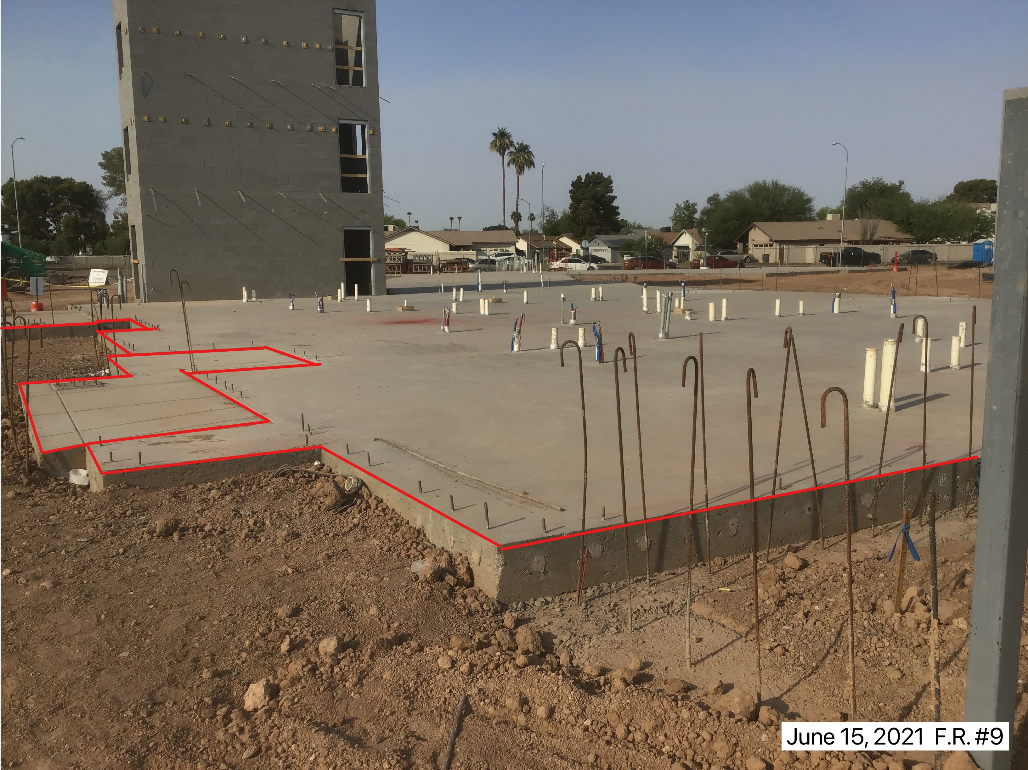
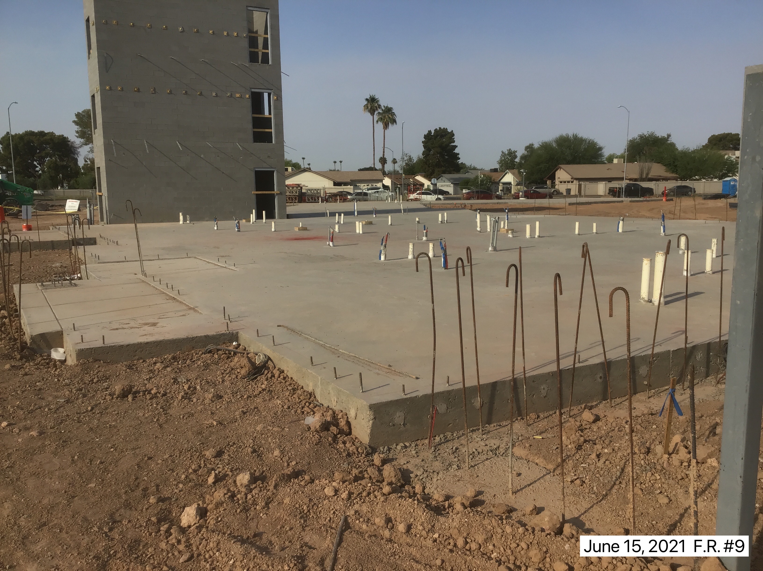
FLOOR PLAN DIMENSIONS AT ORB
METHODOLOGY:
BY PLACING DIMENSIONS ON THE SLAB PLANS, WE WON’T NEED AS MANY DIMENSIONS ON THE ARCHITECTURAL FLOOR PLANS.
THIS PROVIDES:
LESS DIMENSIONING REQUIRED ON ARCHITECTURAL PLANS.
LESS REPEATED INFORMATION BETWEEN SLAB PLANS AND ARCHITECTURAL PLANS
ARCHITECTURAL PLANS ONLY DIMENSION WALLS NOT ASSOCIATED WITH A SLAB EDGE. WALLS CAN BE TIED BACK TO SLAB EDGE, COLUMN OR GRID LINE

Slide 8
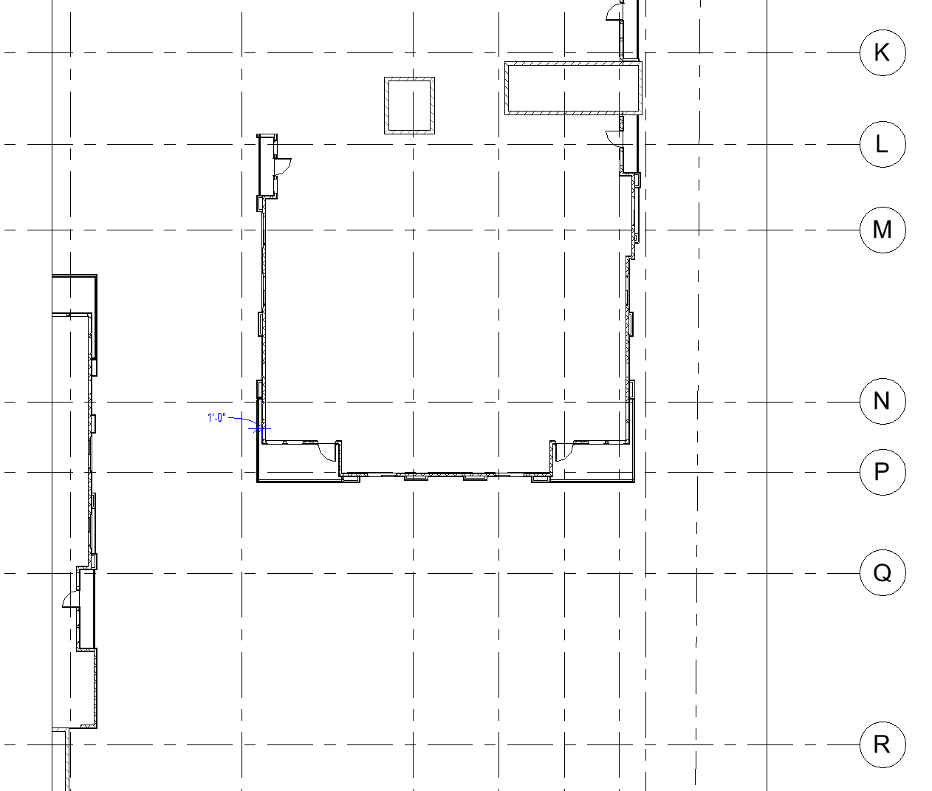
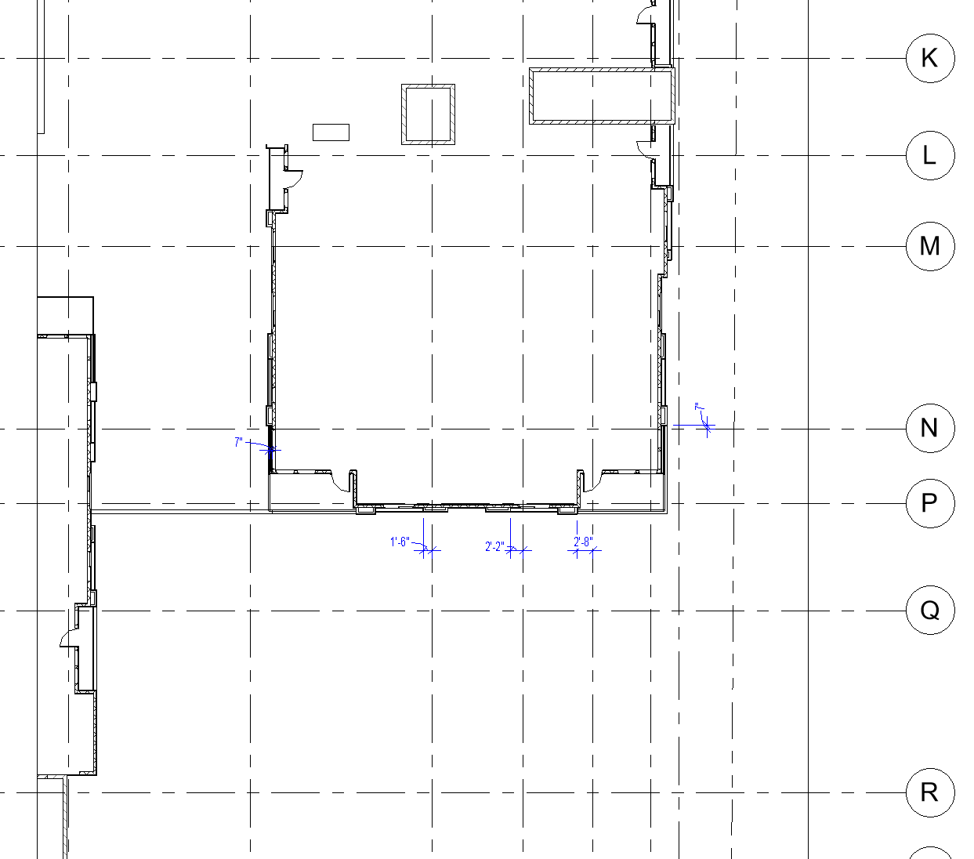
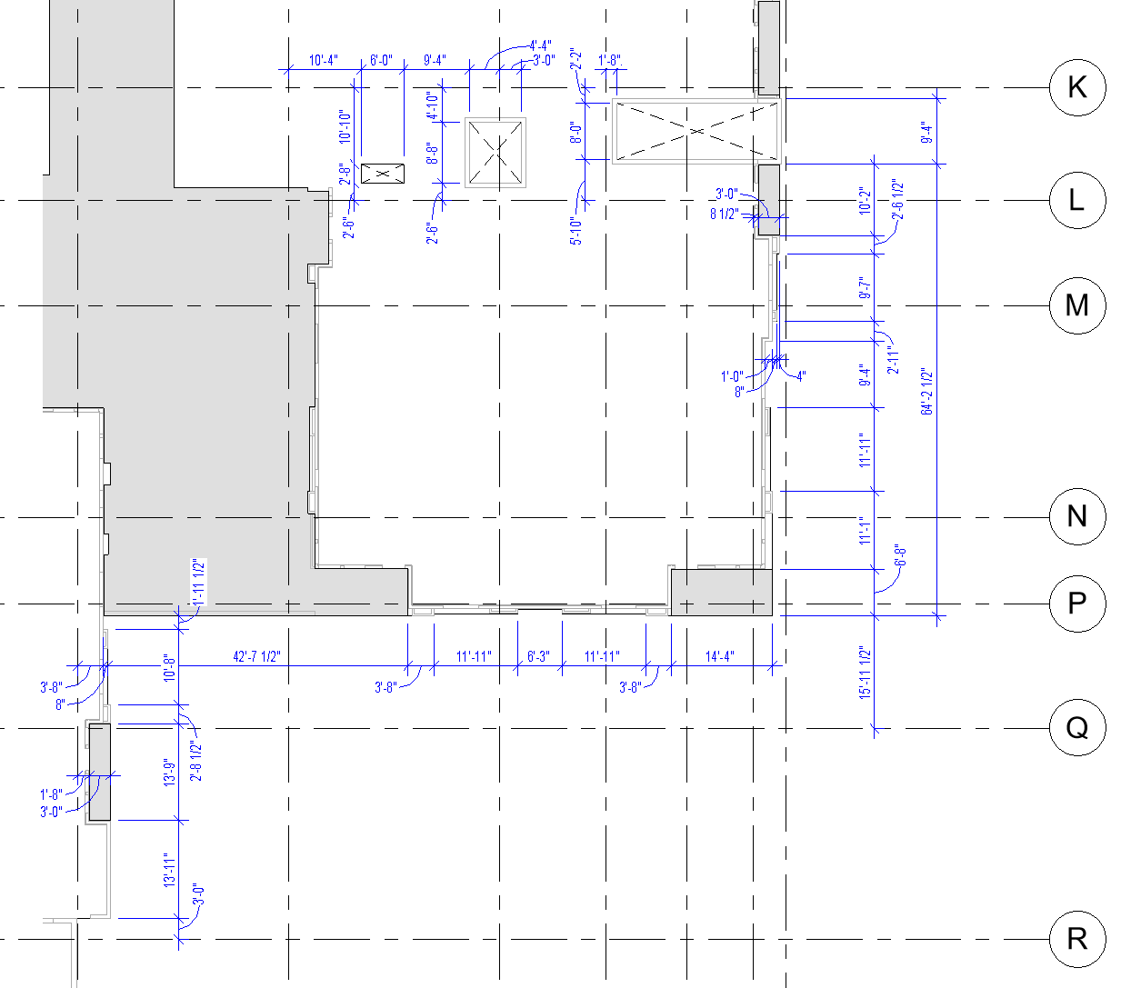
FLOOR PLAN DIMENSIONS AT ORB
METHODOLOGY:
DIMENSION ALL SLAB EDGES
DIMENSION ELEMENTS NOT ASSOCIATED WITH SLAB EDGES (POP OUTS)
DIMENSION ELEMENTS THAT ARE DIFFERENT AT EACH LEVEL
UNIT WINDOWS AND DOORS ARE ONLY DIMENSIONED IF THEY ARE DIFFERENT FROM THE UNIT PLAN LAYOUT (A2 SERIES)

Slide 9
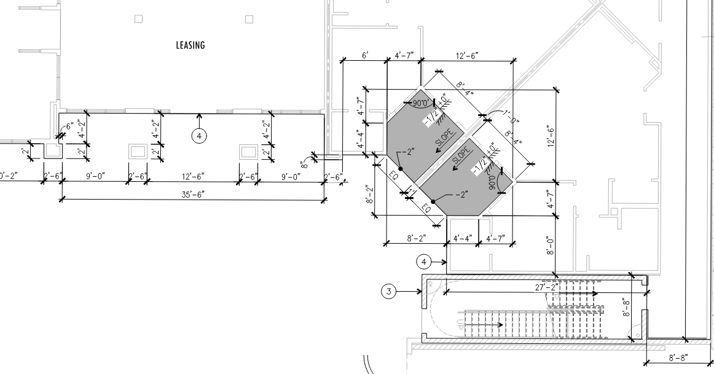
SLAB PLANS
WHAT ITEMS DO YOU DIMENSION?
ON SLAB PLANS:
EXTERIOR SLAB EDGES
LOCATIONS WHERE SLABS HAVE A DIFFERENCE IN LEVEL
ELEVATOR PITS
PATIO SLABS
EXTERIOR COLUMN FOUNDATION SLABS
PROVIDE SLOPES AND DIFFERENCES IN FINISH FLOOR ELEVATIONS SHOWN ON THIS PLAN
TIE MAJOR ELEMENTS TO YOUR GRID LINES IF THEY ARE PART OF THE PROJECT

Slide 10
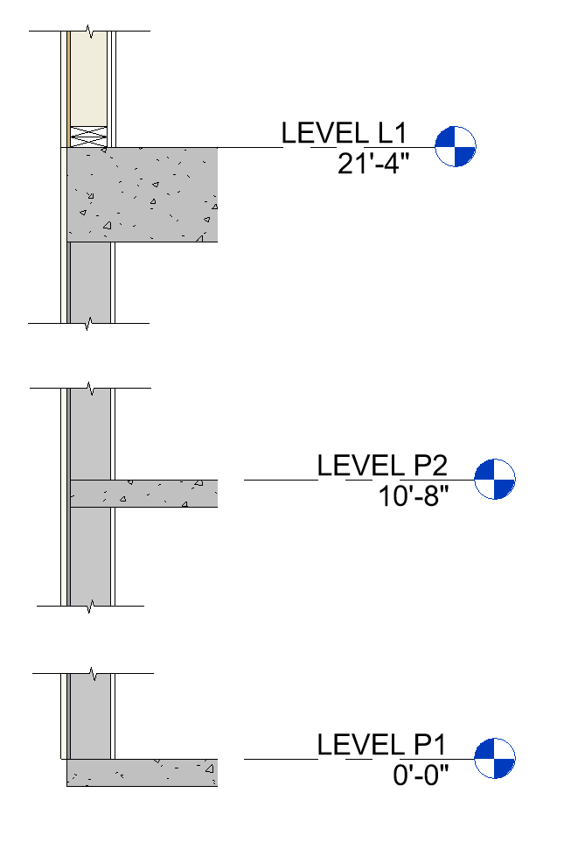
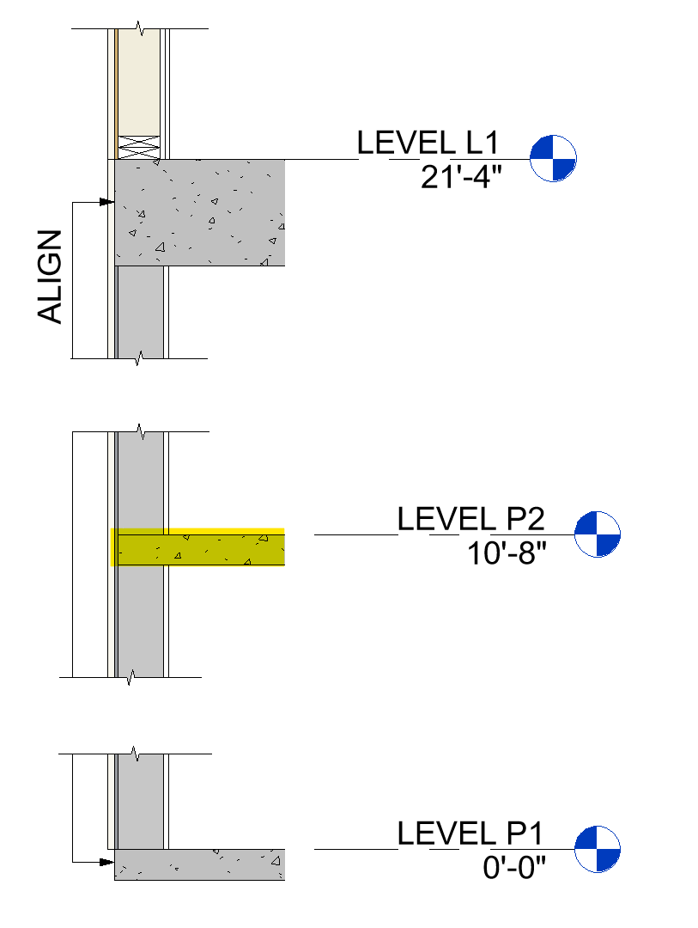
SLAB PLANS
WHAT ITEMS DO YOU DIMENSION?
ON SLAB PLANS:
CONSIDER THE ALIGNMENT OF CONCRETE STRUCTURES.
SLABS AT UPPER FLOORS MAY NOT HAVE THE SAME EDGE AS YOUR GROUND SLAB.

Slide 11
SLAB PLANS
WHAT ITEMS DO YOU DIMENSION?
ON SLAB PLANS:
CONSIDER THE ALIGNMENT OF CONCRETE STRUCTURES.
SLABS AT UPPER FLOORS MAY NOT HAVE THE SAME EDGE AS YOUR GROUND SLAB.
KNOW WHERE YOU ALIGN YOUR SLAB EDGES AT EACH LEVEL

Slide 12
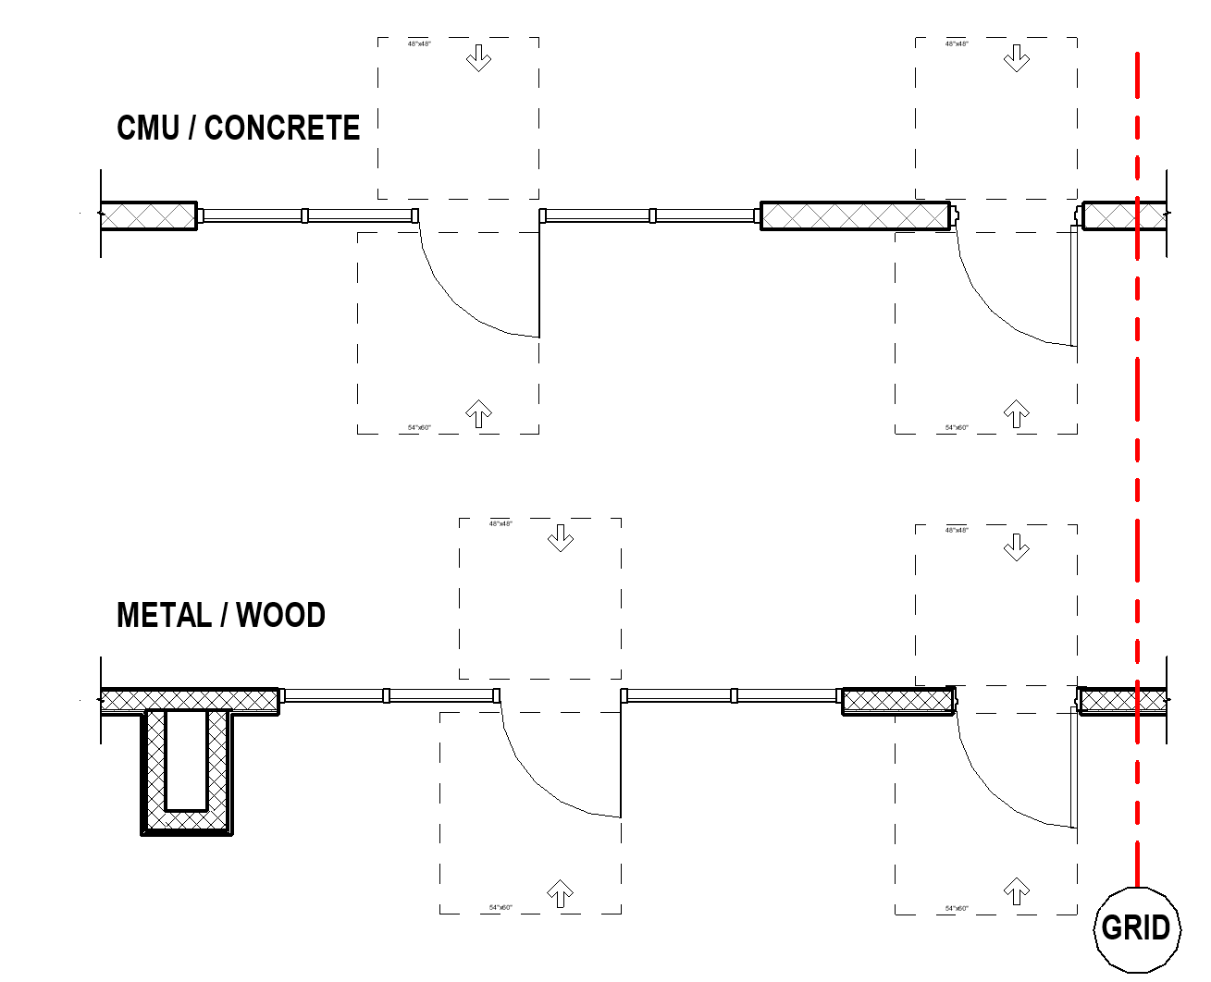
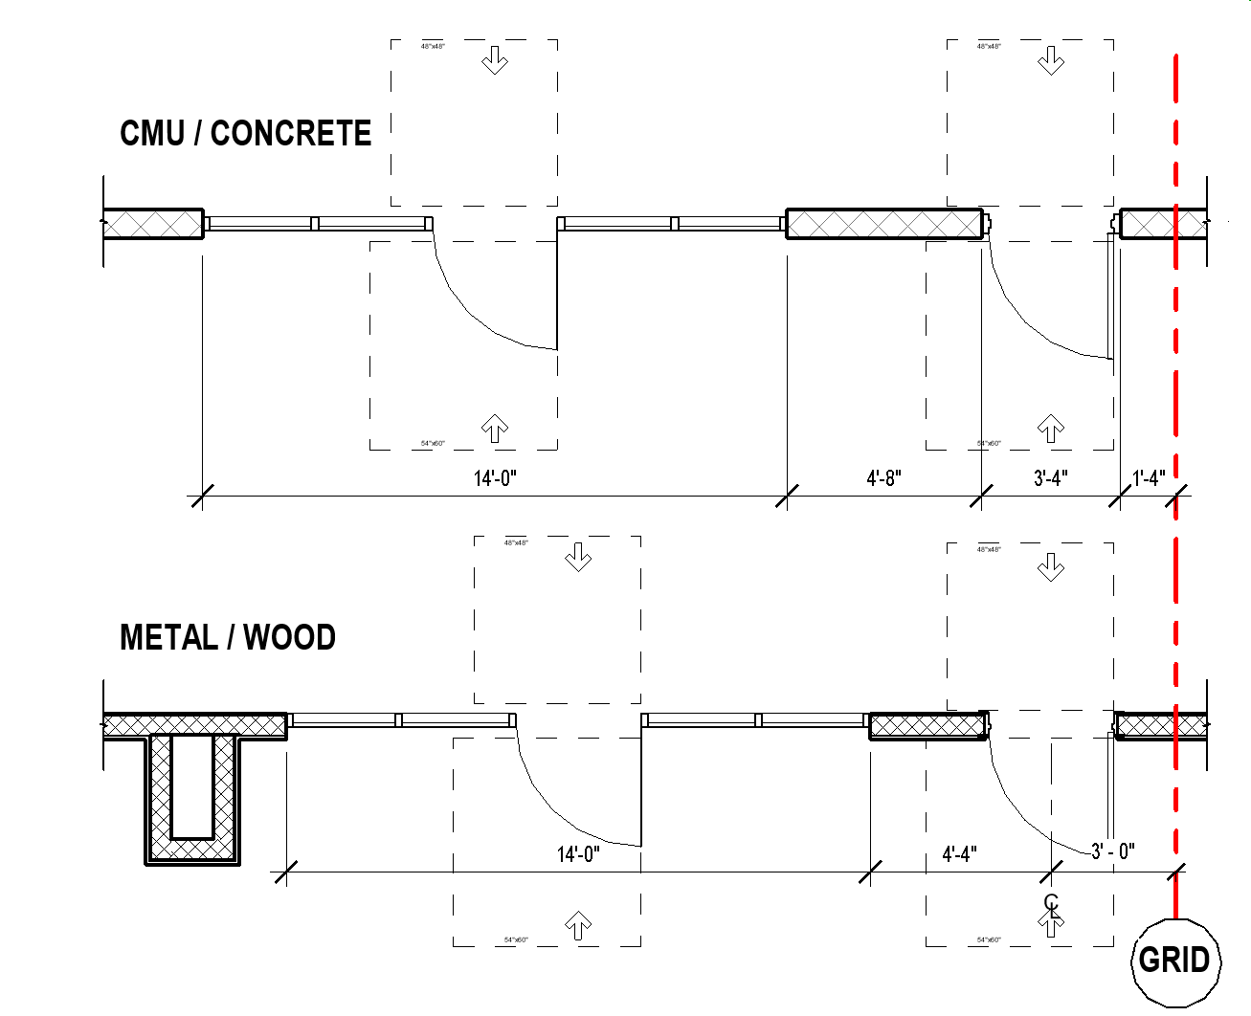
FLOOR PLAN DIMENSIONS
DIMENSIONING ELEMENTS
THE SAME ELEMENTS MAY NEED TO BE DIMENSIONED DIFFERENTLY DEPENDING ON WHERE THEY ARE LOCATED.

Slide 13
FLOOR PLAN DIMENSIONS
DIMENSIONING ELEMENTS
CONCRETE AND MASONRY WALL ELEMENTS ARE MEASURED DIFFERENTLY THAN WOOD & METAL STUDS WALL
ELEMENTS LIKE STOREFRONTS ARE ALWAYS DIMENSIONED THE SAME WAY, REGARDLESS OF THE WALL THEY ARE EMBEDDED IN.
IN CONCRETE AND MASONRY WALLS, DOORS, WINDOWS, AND CLEAR OPENINGS ARE MEASURED TO THE EDGE OF THE OPENING.
IN WOOD AND STUD WALLS, DOORS AND WINDOWS ARE MEASURED TO THE CENTER OF THE OPENING.

Slide 14
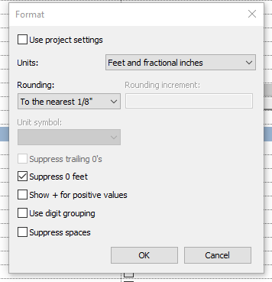
DIMENSIONS
DIMENSIONING ACCURACY
ACCURACY OF YOUR DIMENSIONS DEPENDS ON THE ACCURACY OF YOUR MODEL
DON’T HIDE LAZY MODELING WITH DOCUMENT OR SITE DIMENSIONS

Slide 15
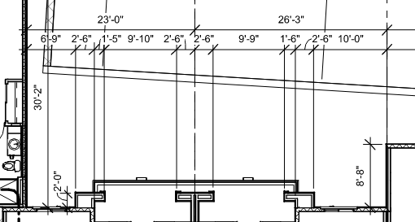
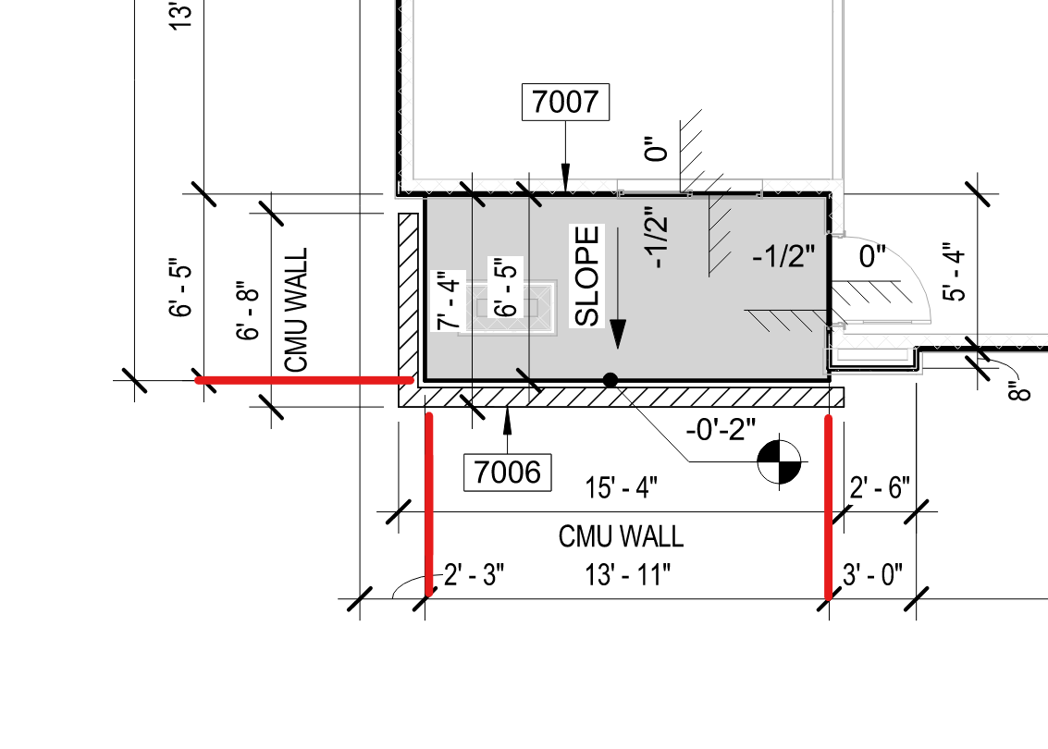
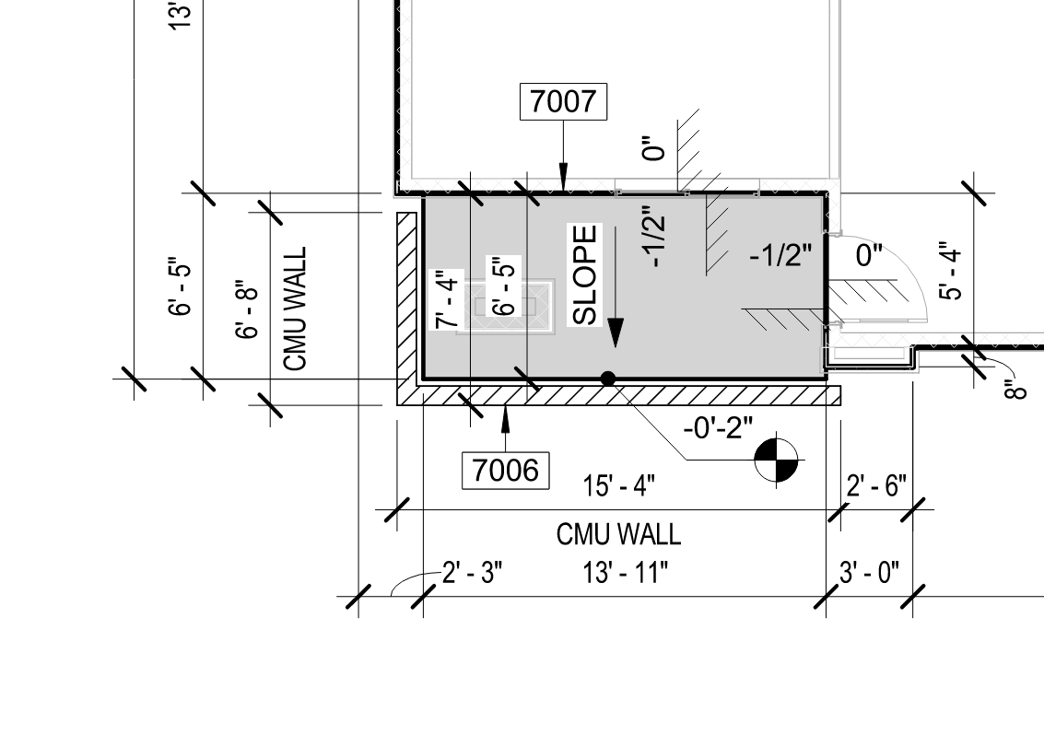
DIMENSIONS
DIMENSIONING ELEMENTS
IT IS VERY EASY TO MISS DIMENSION ORDER WHEN WORKING ON A PROJECT. ALWAYS GO BACK AND CHECK YOUR WORK
OVERCROWDING OF DIMENSIONS CLUTTERS THE DRAWINGS AND MAKES IT HARD TO READ.
DON’T CROSS DIMENSION STRINGS. ADD MORE IF NEEDED OR SHIFT THEM TO THE INSIDE OF THE BUILDING.

Slide 16
DIMENSIONS
DIMENSIONING ELEMENTS
IT IS VERY EASY TO MISS DIMENSION ORDER WHEN WORKING ON A PROJECT. ALWAYS GO BACK AND CHECK YOUR WORK
OVERCROWDING OF DIMENSIONS CLUTTERS THE DRAWINGS AND MAKES IT HARD TO READ.
DON’T CROSS DIMENSION STRINGS. ADD MORE IF NEEDED OR SHIFT THEM TO THE INSIDE OF THE BUILDING.

Slide 17
DIMENSIONS
DIMENSIONING ELEMENTS
IT IS VERY EASY TO MISS DIMENSION ORDER WHEN WORKING ON A PROJECT. ALWAYS GO BACK AND CHECK YOUR WORK
OVERCROWDING OF DIMENSIONS CLUTTERS THE DRAWINGS AND MAKES IT HARD TO READ.
DON’T CROSS DIMENSION STRINGS. ADD MORE IF NEEDED OR SHIFT THEM TO THE INSIDE OF THE BUILDING.
DON’T CROSS THE DIMENSION STRINGS

Slide 18
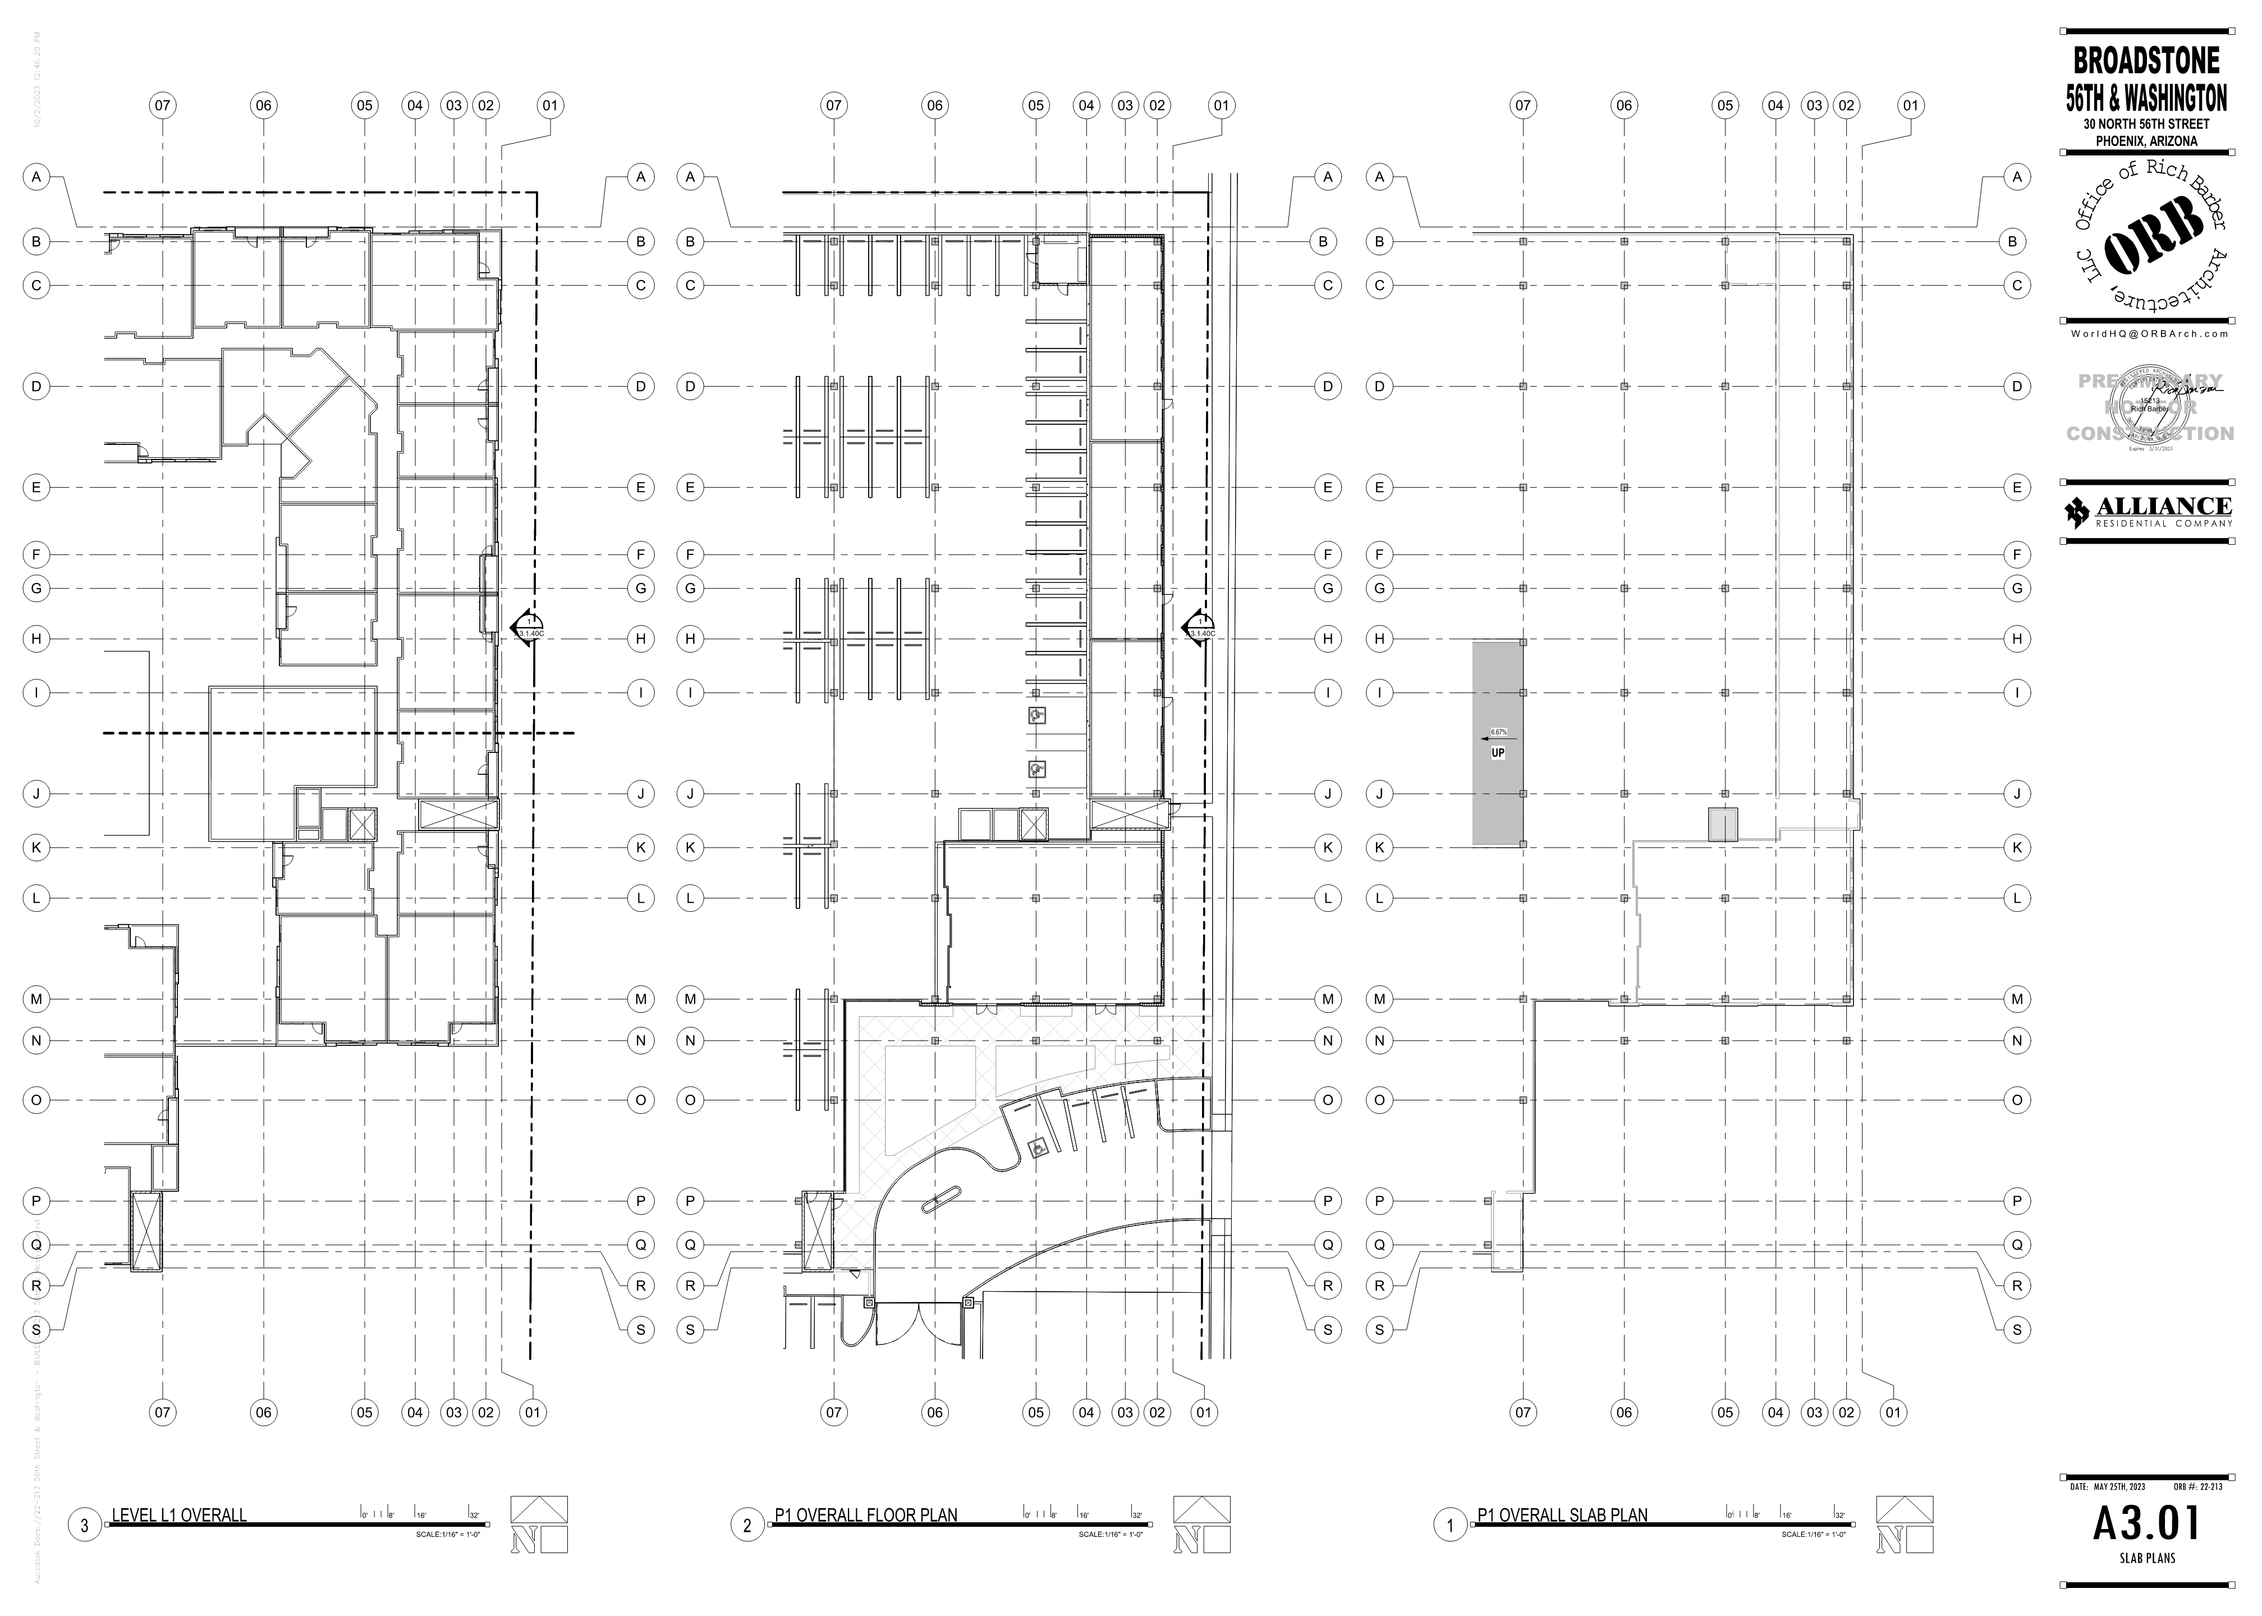
DIMENSIONS – PRACTICAL EXAMPLE

